Slide 1
Desktop Application
Felix Weingartner

Slide 2
Description of the problem
Family Fun Entertainment Center needs an application to help manage their business
Capable of adding and editing employee & customer data
View and print reports

Slide 3
Development process
Static interface
Dynamic interface
Testing & bug fixes
Database manipulation
User input control

Slide 4
Planning Process
Basic features needed
What the theme will be and how the program will flow
How would data from the program be stored
Extra Features to help complete the program
Ideas I wanted to implement
A user-friendly interface
Easy-to-navigate windows
Simple buttons and text
A database server
Keep data centralized
Multiple machines may use application

Slide 5
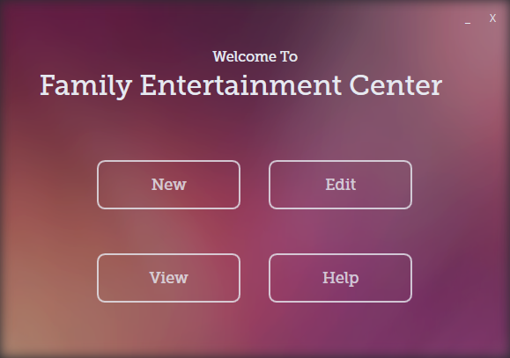
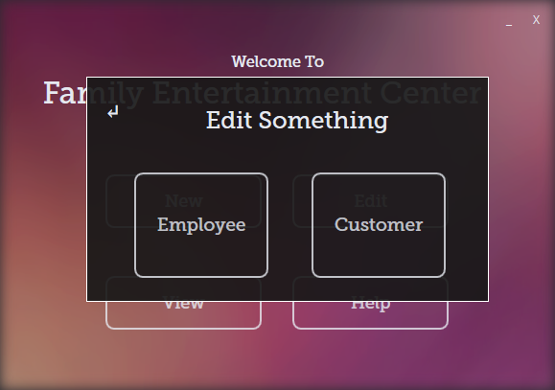
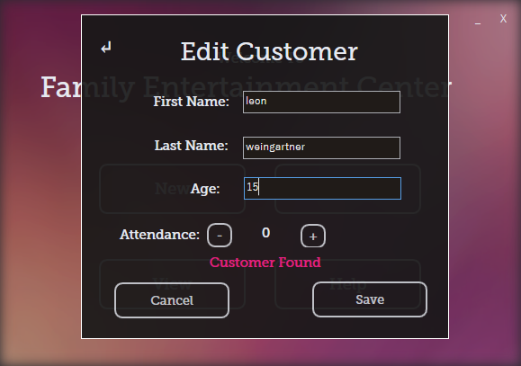
Designing
The designing phase consisted of deciding on
The color and theme
Application interface flowchart
Database structure
Interact-able buttons and data fields

Slide 6
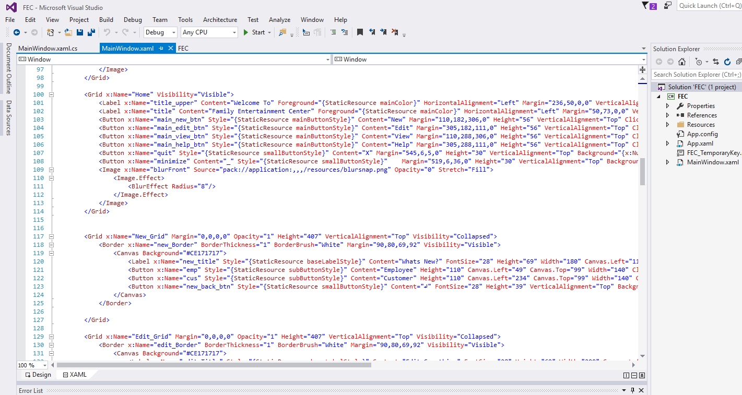
Development
Development, which was predominately coding and debugging
Graphical User Interface in XAML
Application structure and mechanism in C#
Database write/read implementation in SQL
Program totaled to about 2000 lines of code

Slide 7



What I Used
Microsoft Visual Studio (C#)
Microsoft SQL Server
Adobe Photoshop

Slide 8
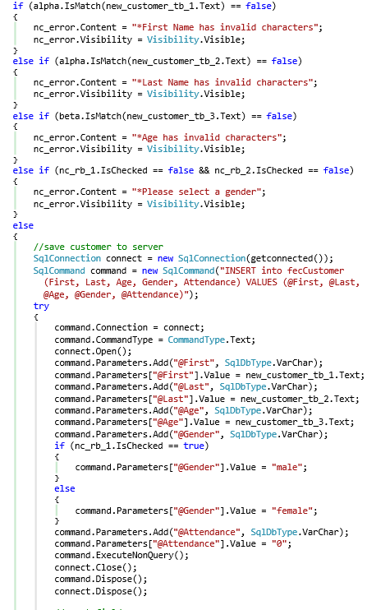
Example of Program Documentation

Slide 9

Debugging
There were some bugs along the way
Missed validation checks like blank username
Small problems with SQL queries
Email format was tricky

Slide 10
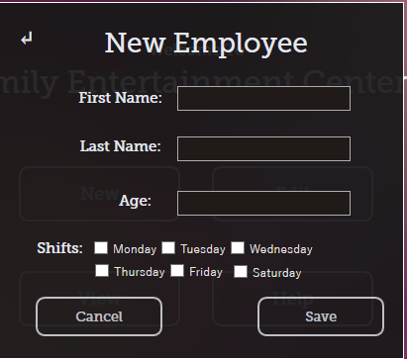
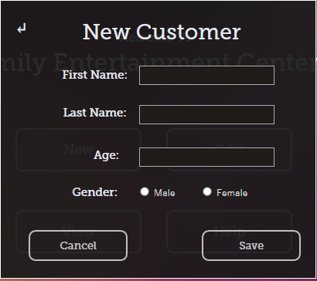
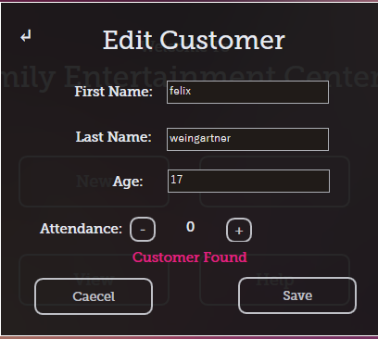
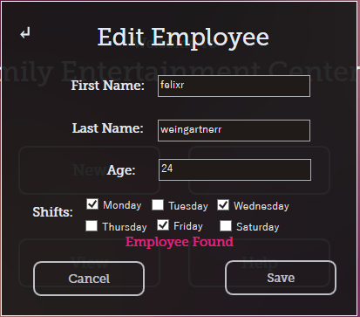

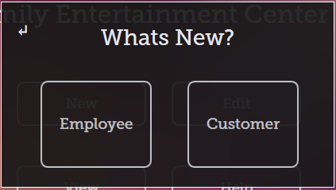
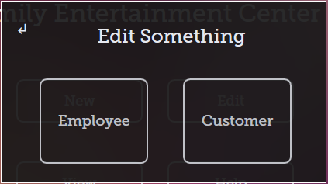
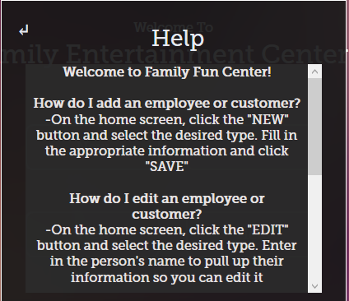
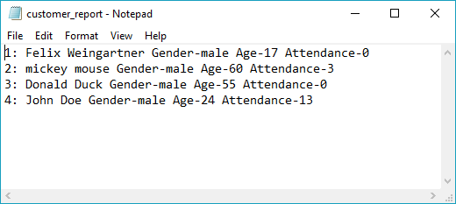
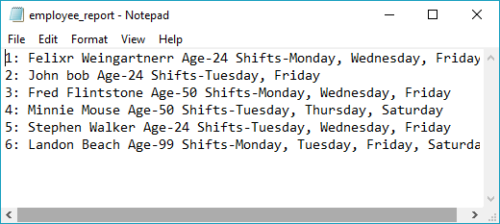
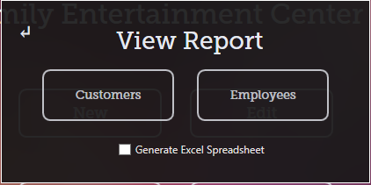
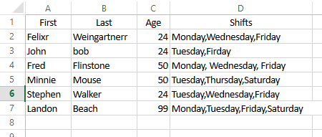
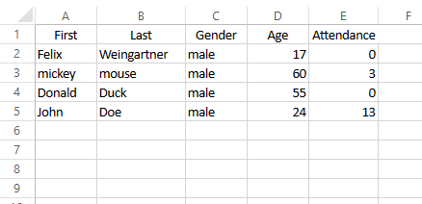
Program Flow
Sql Server db
Customer Report (.txt)
Employee Report (.txt)
Customer Report (.xls)
Employee Report (.xls)
Start
Help

Slide 11
Input/output and program parameters
First Name
Last Name
Start
Edit
.db
First Name
Last Name
Age
Attendance
Shifts
Gender
Load
First Name
Last Name
Age
Attendance
Shifts
Gender
.db
.db
Add
.db
X
Help
Home
Uninstall
Report .txt
New Report
View Report
.db
Report .xls

Slide 12
Usefulness of the program
Key Features
User-friendly interface
User-errors provided
Database server
Easy-to-use record saving and editing
Excel report option for extra managability

Slide 13
What I Learned
Document more
Although I did some, I could’ve done a some more documentation and comments in the code
Decide on variable classification early
Saves a lot of time especially when parsing all the data to the database
Use more encryption with database
Sending sensitive information across to a server can be sniffed, so more encryption could have been implemented (possibly ssl certificates)
Using Microsoft SQL Server as the central database
This enables multiple machines to access central information
To programmatically provide reports from data using sql is very powerful

